Slide 1
2:1-12

Slide 2
2:1-12
1 Peter 2:1–12 ~ ¹ Therefore, laying aside all malice, all deceit, hypocrisy, envy, and all evil speaking, ² as newborn babes, desire the pure milk of the word, that you may grow thereby, ³ if indeed you have tasted that the Lord is gracious.
⁴ Coming to Him as to a living stone, rejected indeed by men, but chosen by God and precious, ⁵ you also, as living stones, are being built up a spiritual house, a holy priesthood, to offer up spiritual sacrifices acceptable to God through Jesus Christ. ⁶ Therefore it is also contained in the Scripture,

Slide 3
2:1-12
1 Peter 2:1–12 ~ “Behold, I lay in Zion
A chief cornerstone, elect, precious,
And he who believes on Him will by no means be put to shame.”
⁷ Therefore, to you who believe, He is precious; but to those who are disobedient,
“The stone which the builders rejected
Has become the chief cornerstone,”
⁸ and
“A stone of stumbling
And a rock of offense.”

Slide 4
2:1-12
1 Peter 2:1–12 ~ They stumble, being disobedient to the word, to which they also were appointed.
⁹ But you are a chosen generation, a royal priesthood, a holy nation, His own special people, that you may proclaim the praises of Him who called you out of darkness into His marvelous light; ¹⁰ who once were not a people but are now the people of God, who had not obtained mercy but now have obtained mercy.
¹¹ Beloved, I beg you as sojourners and pilgrims, abstain from fleshly lusts which war

Slide 5
2:1-12
1 Peter 2:1–12 ~ against the soul, ¹² having your conduct honorable among the Gentiles, that when they speak against you as evildoers, they may, by your good works which they observe, glorify God in the day of visitation.

Slide 6
2:1-12

Slide 7
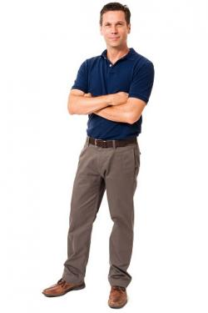
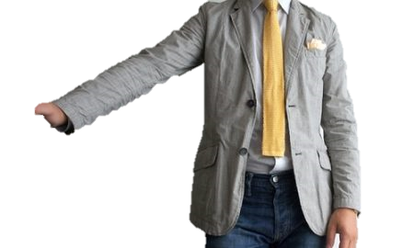
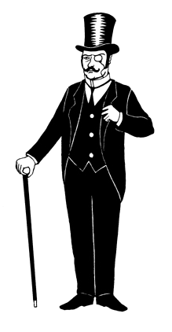
2:1-12
Presby/Reformed
Mega-Church Non-denom
Baptist

Slide 8
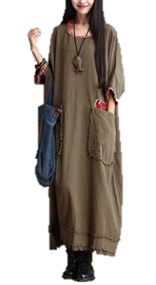
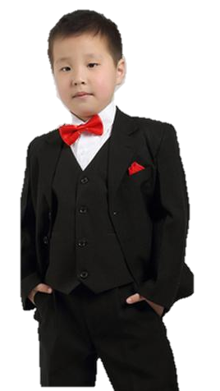
2:1-12
Catholic
Wesley
is my HomeBoy
Methodist
Pentecostal

Slide 9
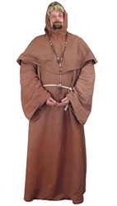
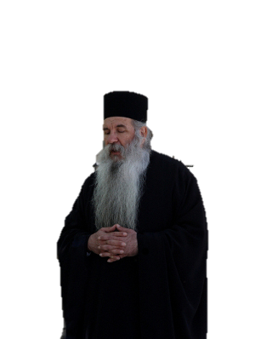
2:1-12
Calvary Chapel
Lutheran
Eastern Orthodox

Slide 10
2:1-12

Slide 11
2:1-12
Works
Bad
Good
Faith
Good enough
in the finished work of Christ
METRONOME
OF
SALVATION

Slide 12
2:1-12

Slide 13
2:1-12
deceit ~ dolos (v. 1)
pure ~ adolos

Slide 14
2:1-12
grow thereby
Adulthood
Adolescence
“Adult” is the past tense form of the Latin word “adolescere”
Childhood
Toddler
Infancy

Slide 15
2:1-12
Søren Kierkegaard ~ “The Bible is very easy to understand. But we Christians are a bunch of scheming swindlers. We pretend to be unable to understand it because we know very well that the minute we understand, we are obliged to act accordingly.”

Slide 16
2:1-12

Slide 17
2:1-12
A. T. Robertson: “Condition of the 1st class” ~ Since

Slide 18
2:1-12

Slide 19
2:1-12
Heb. 13:15 ~ Therefore by Him let us continually offer the sacrifice of praise to God, that is, the fruit of our lips, giving thanks to His name.
Rom. 12:1 ~ I beseech you therefore, brethren, by the mercies of God, that you present your bodies a living sacrifice, holy, acceptable to God, which is your reasonable service.

Slide 20
2:1-12
Ken Merrihew ~ “Growing as a Christian is not a matter of getting more spiritual stuff tomorrow – but learning to apprpriate what we already have today.”
2 Pet. 1:3 ~ as His divine power has given to us all things that pertain to life and godliness, through the knowledge of Him who called us by glory and virtue,

Slide 21
2:1-12
The same power that rose Jesus from the grave
The same power that commands the dead to wake
The same power that moves mountains when He speaks
The same power that can calm a raging sea
Lives in us
~ Jeremy Camp ~

Slide 22
2:1-12

Slide 23
2:1-12
John 3:18 ~ He who believes in Him is not condemned; but he who does not believe is condemned already, because he has not believed in the name of the only begotten Son of God.

Slide 24
2:1-12

Slide 25
2:1-12
1 Cor. 1:23 ~ but we preach Christ crucified, to the Jews a stumbling block and to the Greeks foolishness,
Two kinds:
1. The saints
2. The ain’ts
a. Those that know they’re ain’ts
b. Those that think they’re saints but are ain’ts

Slide 26
2:1-12

Slide 27
2:1-12
But you ~ emphatic
generation ~ genos
NASB, race; NIV, people
catholic
1. Of broad or liberal scope; comprehensive
2. Including or concerning all humankind; universal:
own special ~ eis + peripoiēsis – a purchased possession

Slide 28
2:1-12

Slide 29
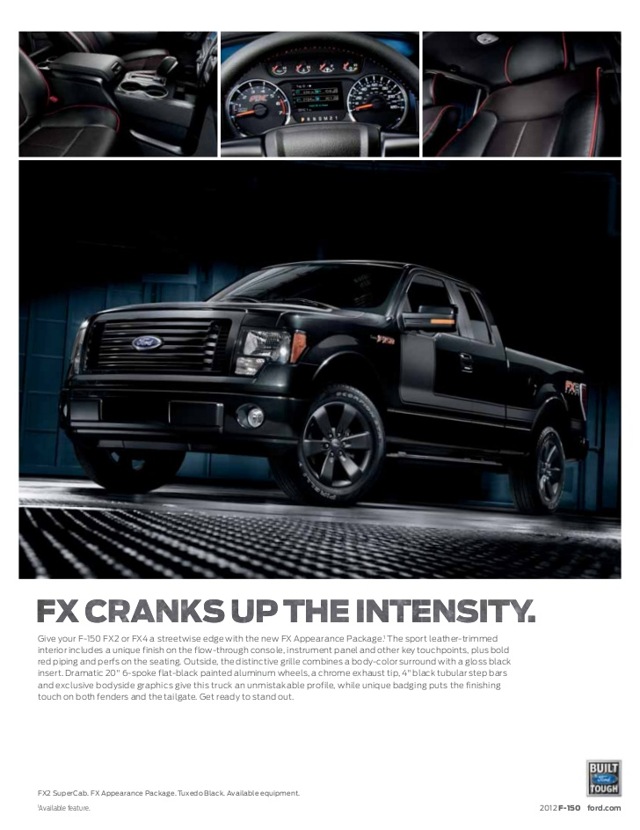
2:1-12
Gal. 6:8a ~ For he who sows to his flesh will of the flesh reap corruption,

Slide 30
2:1-12

Slide 31
2:1-12
visitation ~ episkopē – verb form of episkopos, overseer
episkopos – bisceop – bishop
Greek OE English
Literally, examination

Slide 32
2:1-12

